Slide 1
BIG DATA
WELCOME
TO

Slide 2
What is streaming?
So far we’ve really just talked about processing historical, existing big data
Sitting on HDFS
Sitting in a database
But how does new data get into your cluster? Especially if it’s “Big data”?
New log entries from your web servers
New sensor data from your IoT system
New stock trades
Streaming lets you publish this data, in real time, to your cluster.
And you can even process it in real time as it comes in!

Slide 3
TWO PROBLEMS
How to get data from many different sources flowing into your cluster
Processing it when it gets there

Slide 4
MESSAGING SYSTEM
A Messaging System is responsible for transferring data from one application to another
Two types of messaging patterns are available
Point to point
Publish-subscribe (pub-sub) messaging system

Slide 5
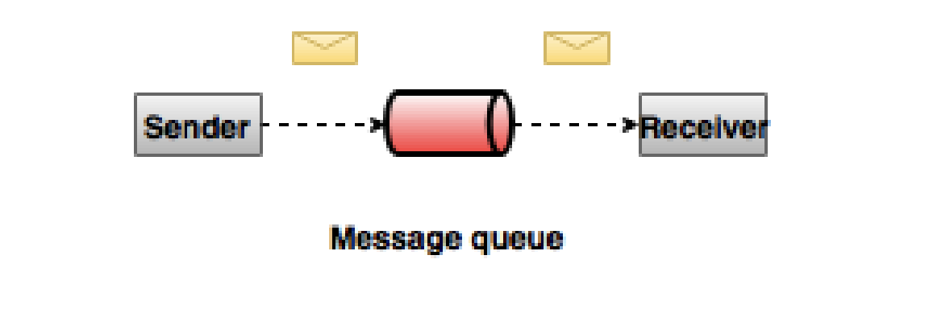
Point to point
Messages are persisted in a queue
One sender and one receiver
Once a consumer reads a message in the queue, it disappears from that queue

Slide 6
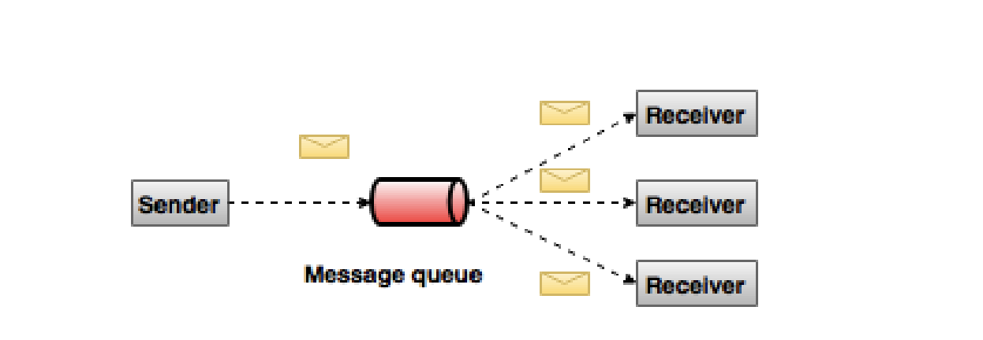
publish-subscribe
Messages are persisted in a topic
Consumers can subscribe to one or more topic and consume all the messages in that topic.
Many senders and many receivers

Slide 7
Kafka
Kafka is a general-purpose publish/subscribe messaging system
Kafka servers store all incoming messages from publishers for some period of and publishes them to a stream of data called a topic.
Kafka consumers subscribe to one or more topics, and receive data as it’s published
A stream / topic can have many different consumers, all with their own position in the stream maintained

Slide 8
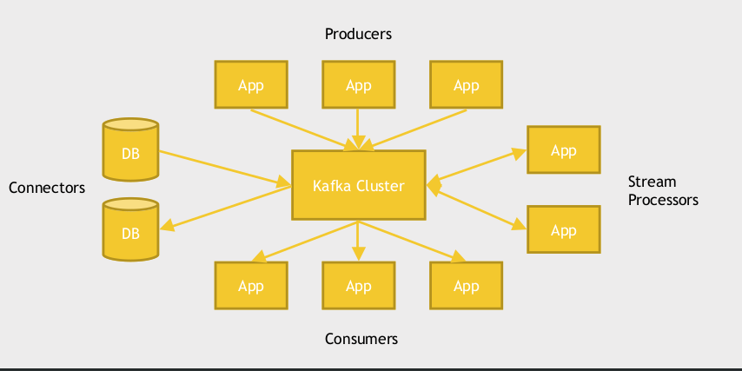
Kafka Works

Slide 9
Components
Topics - A stream of messages belonging to a particular category is called a topic. Data is stored in topics.
Brokers - Brokers are simple system responsible for maintaining the published data.
Kafka Cluster - Having more than one broker are called as Kafka cluster
Producers- Producers are the publisher of messages to one or more Kafka topics. Producers send data to Kafka brokers.
Consumers - Consumers read data from brokers.

Slide 10
Zookeeper
Apache Zookeeper is a coordination service for distributed application that enables synchronization across a cluster.
Cluster manager
Manage configuration across nodes.
Implement reliable messaging.
Implement redundant services.
Synchronize process execution.

Slide 11
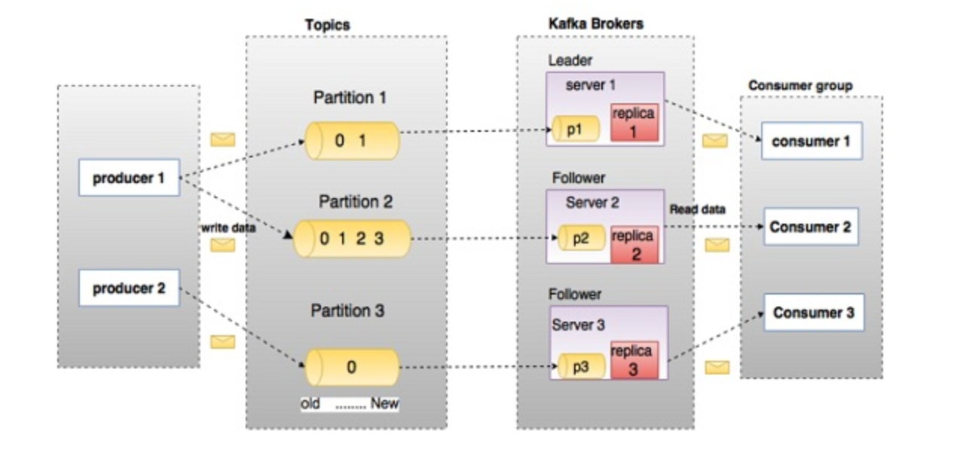
Fundamentals

